Slide 1

the Conflict in Sudan: searching for solutions
Phase 3: Project | Peter gaduel

Slide 2
Presentation outline
1. INTRODUCTIONS
1.1 Overview & problem statement
1.2 Business and Data Understanding
2. EDA & KEY FINDINGS
2.1 Results
2.2 Modeling & Evaluation
3. CONCLUSIONS
3.1 Recommendations

Slide 3
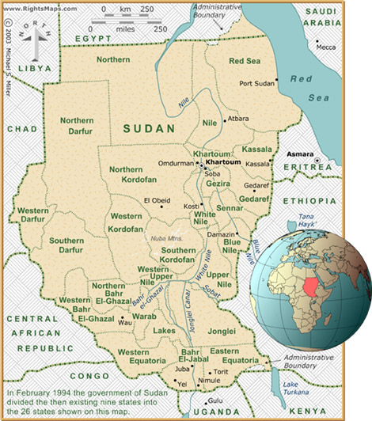
1: Introductions
Overview & Problem statement
Sudan has been a violent hotspot in Africa due to political instability since 1997.
With the increasing level of violence, there is need to understand, the drivers of violence in Sudan, the role of various actors in violent conflict.
This project uses the ACLED Data to analyze Sudan violence and predict the impact on fatalities using regression model and random forest.

Slide 4

1.2: Business understanding
Peacebuilding interventions require thorough understanding of local context such as influence of actors, affected categories of people.
The analysis from this project will advise peacebuilding partners on how to address the underlying causes of violence in Sudan.
It will draw conclusions aimed at choosing appropriate peace building program such as strengthening rule of law and security institutions.

Slide 5
2. EDA & KEY FINDINGS
This section involve inferential analysis based on key variables
It will answer the following questions:
What is the most common type of violence in Sudan?
Which actors are responsible for most of violent counts in Sudan?
Where is violence concentrated in Sudan ; and what are the top 10 regions in Sudan with the highest count of fatalities?

Slide 6
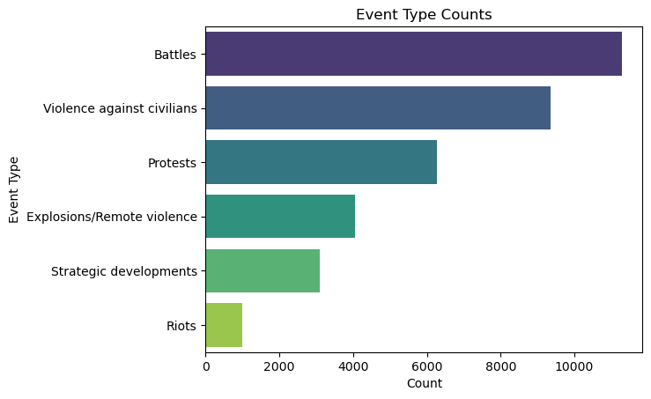
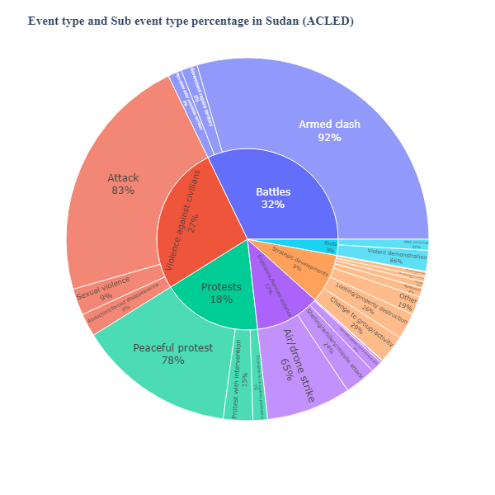
2.1: EDA & Key findings
What is the most common type of violence in Sudan?
From the visuals, battles constitute the largest proportion of violent incidents with more than 10,000 counts of fatalities per year.
Riots are the least type of violent incidents in Sudan
Most of the battles are basically armed clashes.

Slide 7
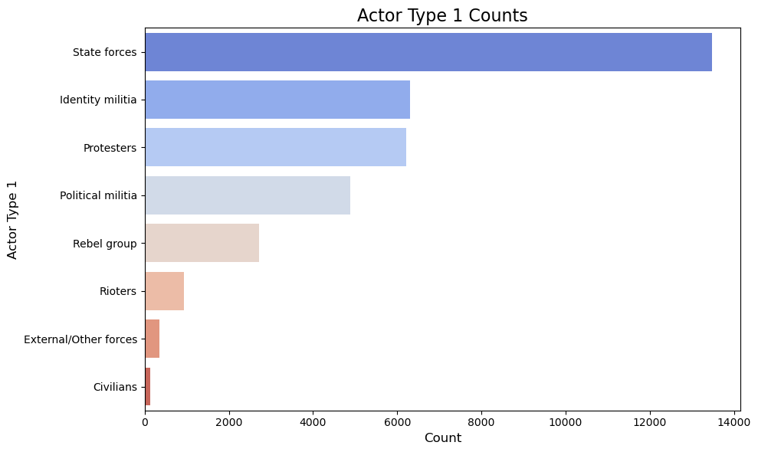
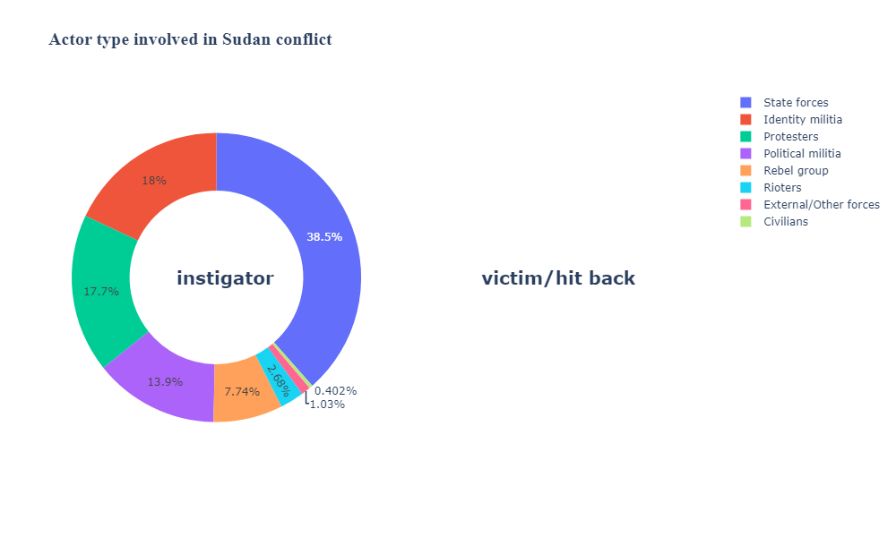
2.2: EDA & Key findings-contin.
Which actors are responsible for most of violent counts in Sudan?
The state forces are the primary perpetrators in Sudan conflict linked with over 38% of violent counts
Other actors are identity militia and protestors

Slide 8
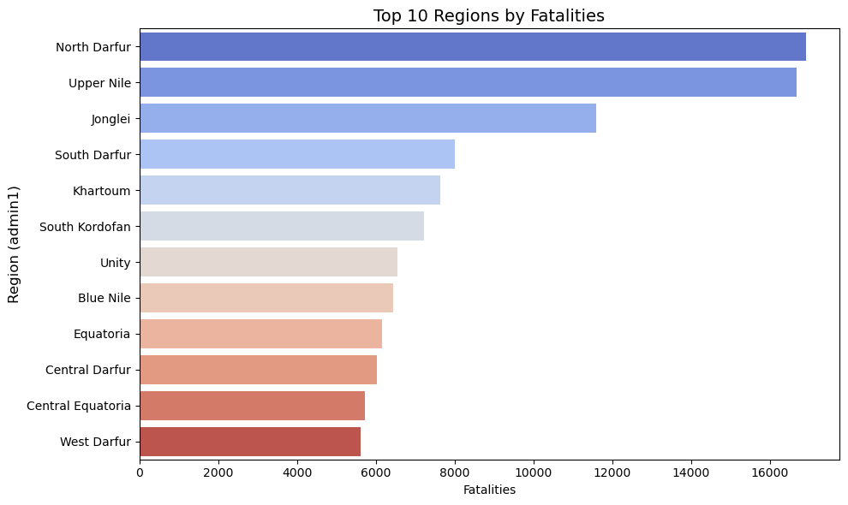
2.3: EDA & Key findings-contin.
What are the top 10 regions in Sudan with the highest count of fatalities?
According to the Bar Chart;
North Darfur region is the most affected hotspot in Sudan with over 16000 fatalities
Upper Nile is the second most affected region by war
West Darfur is the least affected region with low fatalities count.

Slide 9
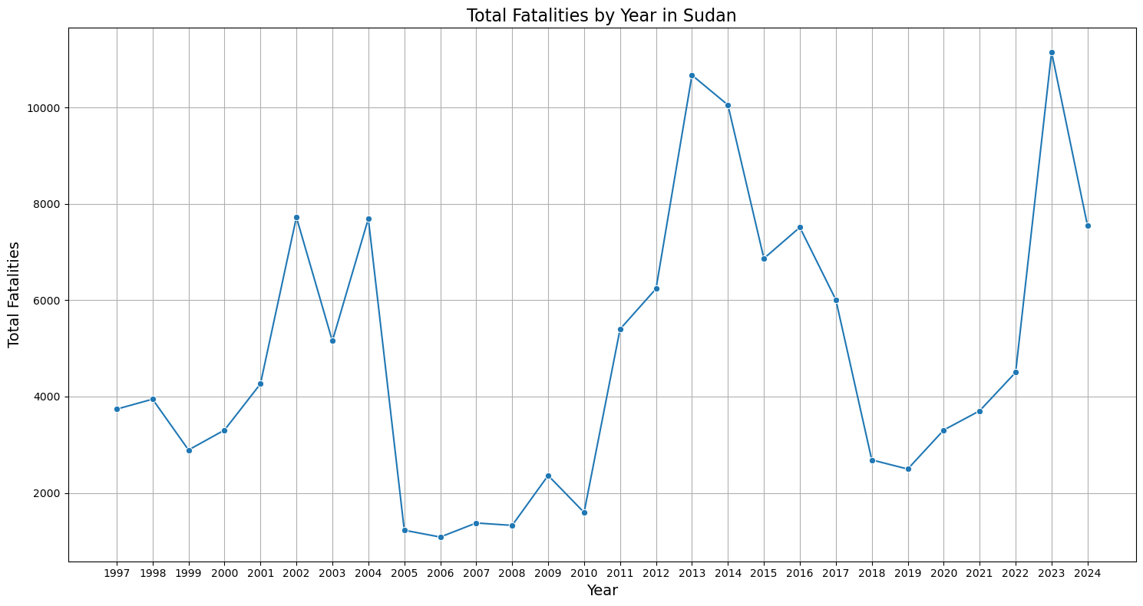
2.4: EDA & Key findings-contin.
When did Sudan record the highest number of fatalities?
The highest fatalities count in Sudan was recorded in 2023, and 2013 with over 10,000 deaths
The quietest period was between 2005 to 2010 with lowest record of violent deaths
There was an upward trend in violence between 1999 to 2002, 2010 - 2013 , and 2020 - 2023.
There was a sharp decline of fatalities between 2004 -2010, 2014 -2022.

Slide 10
2.5: Modeling
I will use linear regression model and Random forest regressor to evaluate the metrics for my analysis.
In both models, I will use the R2_score to evaluate the effectiveness of my prediction.
The R² (R-squared) score is a measure of how well the independent variables (features) in my model explain the variability of the target variable ("Fatalities").
Explanation
The model explain only 43.47% of the variance in the training dataset's target variable ("Fatalities")
The explanation is moderate suggesting some relationships are not clearly explained but has room for improvement.
Linear Regression
Train R^2: 0.4347308718794314
Train R^2: 0.3043523148504288

Slide 11
2.6: Modeling: Contin..
Random Forest Regressor
The model explains 86.18 per cent of the variance in fatalities within training dataset.
This indicate the model fits well with training dataset.
The model fails to generalize to unseen data, which makes it unreliable for predicting "Fatalities“.

Slide 12
3: Conclusions
Armed clashes are the most violent events in Sudan
The State Security Forces are the main perpetrators of violence in Sudan conflict
Most of the violence in Sudan is concentrated in North Darfur, Upper Nile, Jonglei and South Darfur region
The most violent period in Sudan is between 2012 – 2014, and 2022 – 2023

Slide 13
3.1: Recommendations
More peacebuilding efforts should be done in North Darfur, Upper Nile and Jonglei regions
Peacebuilding effort in Sudan should be directed to rule of law and security sector reform
There is need to disarm identity militias to mitigate violence

Slide 14

Thank you!

